Slide 1
Getting started with SharePoint Framework
Basic React web part structure

Slide 2
Agenda
How to create React web part
Structure of the basic template
How to extend the solution
Q&A

Slide 3
How to create React web part
Create a new web part by running the Yeoman SharePoint Generator.
> yo @microsoft/sharepoint
Setup the web part information.
Select the React framework.
What framework would you like to start with?
No javaScript web framework
React
Knockout

Slide 4
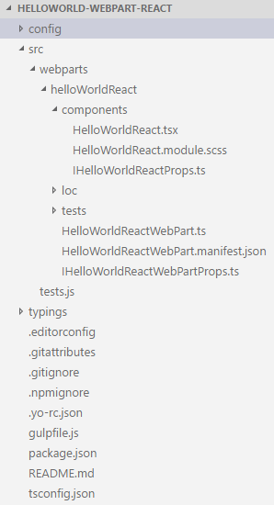
Structure of the basic template
Top level folders
config: includes Visual Studio Code integration files
src: this is the main folder of the project, it includes the web part, styles, and a test file.
typings: includes all type definition files

Slide 5
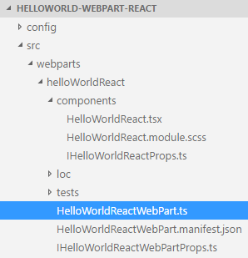
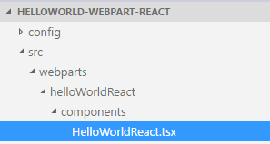
Key files – web part class
Defines the main entry point for the web part
Render and return the main element

Slide 6
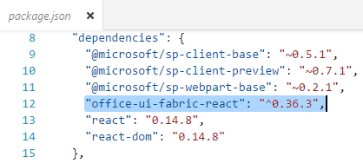
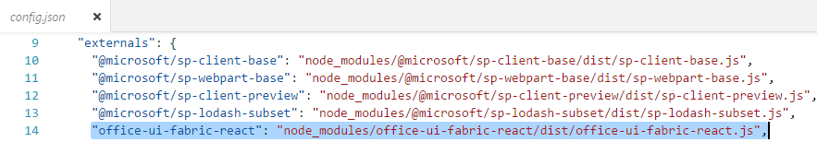
How to extend the solution
Add an Office UI Fabric component package
> npm i office-ui-fabric-react --save
After installed the package.json and config/config.json are updated.

Slide 7
DEMO
Basic React web part structure

Slide 8
Summary
How to create React web part
Structure of the basic template
How to extend the solution
Q&A

Slide 9

Sharing is caring…
Code samples and solutions
Reusable components
Guidance documentation
Monthly community calls
SharePoint Framework
SharePoint add-ins
Microsoft Graph
Office 365 APIs
http://aka.ms/SharePointPnP

Slide 10

Q&A

Slide 11


